Slide 1
SETTING OF PRIVATE CLOUD
AND
HOSTING A PRIVATE CLOUD
BY
CHAYAN SARDAR
MADHUSUDAN GHOSH
PRATIK GHATAK
SOUGATA MAHATA
UNDER GUIDANCE OF
MRS. GOPA MANDAL
ASST. PROFESSOR
DEPARTMENT OF COMPTER SCIENCE AND ENGINEERING
KALYANI GOVERNMENT ENGINEERING COLLEGE

Slide 2
INTRODUCTION
A cloud server based quiz portal.
Allows students to login into their respective accounts and participate in an online quiz competition.
Uses a private cloud.
Private cloud was set up using ownCloud.
CONTENT

Slide 3
User Sign Up
User Log In
Proceed To Quiz
Start Quiz
Get Result
Check Rank
STAGES INVOLVED IN QUIZ PORTAL
CONTENT

Slide 4
FEATURES OF THE QUIZ PORTAL
Real-time quiz features are included.
A timer starts the instant user starts the quiz.
When the timer runs out the answers are auto submitted.
Shuffling of options are done, to create different question sets.
CONTENT

Slide 5
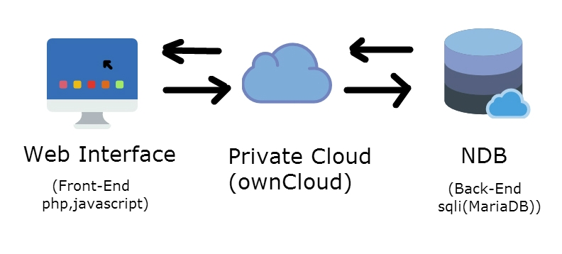
OVERVIEW OF QUIZ PORTAL ARCHITECTURE
FIG: QUIZ PORTAL ARCHITECTURE
CONTENT

Slide 6
WHY USE CLOUD??
Unlike client-server model cloud reduces congestion in network.
More secure as uses Network Database (NDb).
Better performance as it uses clustering of cloud nodes.
CONTENT

Slide 7
WHY USE PRIVATE CLOUD ??
Offering resources (infrastructure and applications) as services
Flexibility and scale that meet client demands
Resource sharing among a large number of users
Measurement and payment according to use of the service
Use of Internet protocols and technologies to access cloud resources
CONTENT

Slide 8
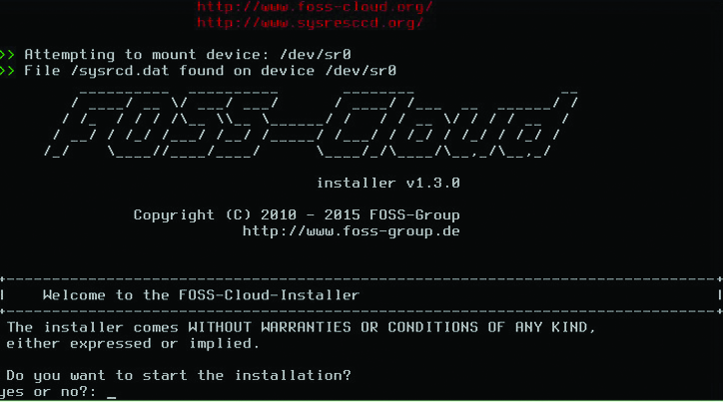
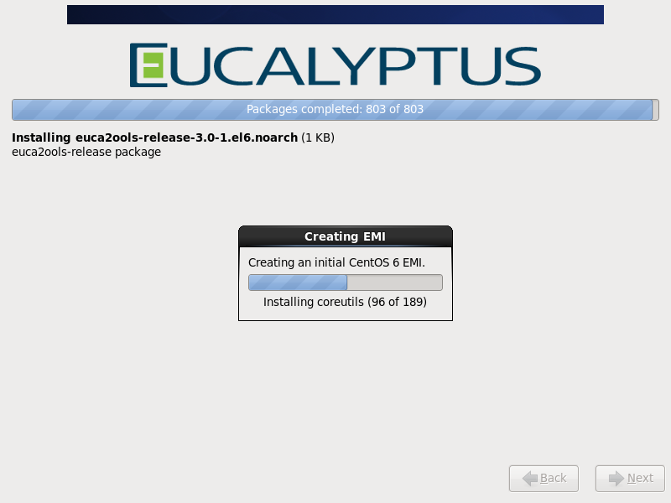
CLOUDS WE HAVE WORKED WITH
CONTENT
FIG: Foss Cloud
FIG: Eucalyptus

Slide 9
CLOUD USED : THE OWNCLOUD
Open source cloud environment written in PHP mainly used for file sharing and syncing with the main cloud server.
ownCloud must be used as a data server. Each user have a separate account to manage and can share data with other users.
It is not for backup storage service.
It can be seen as a cloud providing storage as a service.
ownCloud Enterprise cloud be used to sync multiple ownCloud data servers having a central load balancing server.
CONTENT

Slide 10
OWNCLOUD APPLICATIONS
Game
Shared Calendar
Chatting Application
Encryption
1.Server Side Encryption
2.Client Side Encryption (soon)
Video & Music player
Photo viewer
File Sharing
CONTENT

Slide 11
OWNCLOUD GAME
Local multiplayer Pong game
Single Player tic-tac-toe
Minesweeper
Five in a row
The total is write
Sudoku
Sokogo
Quiz Portal
CONTENT

Slide 12
Pong Game
Local Multiplayer Pong :
Pong is a two-dimensional local multiplayer sports game that simulates
table tennis. The player controls the game paddle by moving it vertically across one side of the screen.
Fig: Pong Game
CONTENT

Slide 13
ADVANTAGES OF ONLINE QUIZ PORTAL
Multi user accessibility
Work from anywhere
Flexibility
Security
Instant Result with Ranking
CONTENT

Slide 14
CONCLUSION AND FUTURE WORK
There has been loads of open source work going on still regarding improving the features of ownCloud
CONTENT

Slide 15
REFERENCE
[1] https://epic.org/privacy/cloudcomputing/
[2] https://www.wikipidia.org/cloudcomputing
[3] https://www.cloudcomputingworld.co.uk
[4] https://computer.org
[5] https://owncloud.org
[6] Author Dr. N. Chandrasekharan. Book: Essentials of Cloud Computing
[7] http://www.computerweekly.com/feature/A-history-of-cloud-computing
CONTENT

